Slide 1
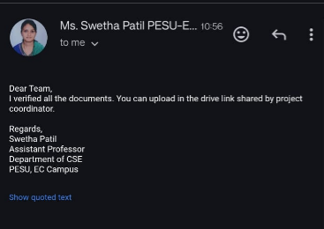

Slide 2
UE22CS320A – Project Phase – 2
Capstone Project – Phase 2 – ESA
PROJECT TITLE : AVIOS – Adaptive Vigilant Intelligent Operating System
PROJECT ID : Team 144
PROJECT GUIDE : Prof. Swetha Patil
PROJECT TEAM
Kurumeti Prajval ( PES2UG22CS274 )
Manoj Kumar KS ( PES2UG22CS302 )
Dhanushree K ( PES2UG22CS176 )
Nagaratna ( PES2UG22CS331 )

Slide 3
Outline
Abstract
Suggestions from Review – 1
Suggestions from Review – 2
Analysis and Critique of Research/Relevance -Application in Real world
High Level Design
Design Methodology
Project Progress (Minimum 20% implementation)
Data Preprocessing and Base Model Implementation
Individual Contribution
References

Slide 4
Abstract
Abstract :
AVIOS – Adaptive Vigilant Intelligent Operating System introduces AI-powered task scheduling in the Linux kernel to dynamically allocate CPU resources based on real-time process behaviour. By leveraging machine learning models in user space to predict optimal time slices (vruntime) and modifying scheduling policies via system calls, AVIOS enhances system efficiency, reduces latency, and optimizes CPU utilization for diverse workloads.

Slide 5
Suggestions from Phase-1
Moving Forward with AI Task Scheduling Feature
After careful consideration and feedback, we have decided to focus on AI-based Task Scheduling as the primary feature of our project. This decision is based on its potential to optimize task execution, improve efficiency, and enhance system performance.

Slide 6
Suggestions from Phase-2
Our project guide, Prof. Swetha Patil, emphasized the importance of continuously enhancing the quality and volume of data used for training our classification models. While our current implementation leverages a Generative Adversarial Network (GAN) to augment a relatively small dataset and synthetically generate diverse task samples, the guide recommended focusing on the collection of real, system-generated data to further improve the accuracy, generalizability, and reliability of our AI models.

Slide 7
Analysis and Critique of Research/Relevance -Application in Real world
Strengths:
Foundational CPU scheduling strategies such as the Completely Fair Scheduler (CFS) provide a well-established model for ensuring equitable CPU time distribution among processes.
Emerging research has explored the integration of artificial intelligence for forecasting resource demands, yielding notable performance gains in controlled or simulated settings.
Weaknesses:
Static scheduling fails to adapt to varying workloads in real-time.
Prior works lack dynamic feedback mechanisms and have limited support for mixed-task environments.
Identified Gaps and Improvements:
Limited exploration of adaptive, lightweight AI models in kernel-level scheduling.
Existing models don't generalize across devices (desktop, mobile, cloud).
Improvement lies in integrating real-time metrics with reinforcement-based learning strategies.

Slide 8
Analysis and Critique of Research/Relevance -Application in Real world
Relevance:
Aligns with current industry challenges like dynamic workloads, multitasking, and energy efficiency.
Tackles real-world problems in cloud computing, edge devices, and mobile platforms.
Bridges the gap between AI predictions and OS-level resource control, providing a more intelligent and responsive system scheduler.
Application in the Real World:
Practical Implementation:
Can be embedded in Linux-based systems as a plug-in scheduler.
Suitable for environments with diverse task profiles, like gaming, real-time data processing, or multitasking user desktops.
Use Cases and Scalability:
Data centers to optimize CPU cycles across VMs.
Smartphones to reduce lag and save battery by postponing background processes.
Industrial and robotics systems needing real-time performance with adaptive load balancing.

Slide 9
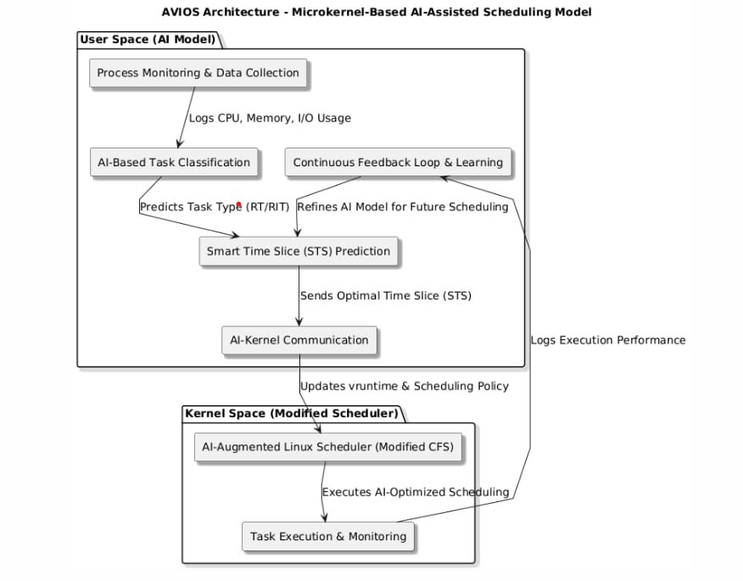
High-level design

Slide 10
High-level design
This architecture follows a Microkernel-based AI-Assisted Scheduling approach. The AI Model in user space that classifies tasks and analyzes the workload of Program X and predicts an optimal Smart Time Slice (STS). It then makes a system call to the Modified Scheduler in kernel space, which dynamically adjusts CPU allocation based on AI recommendations. The scheduler enforces the AI-determined time slice and assigns CPU cycles accordingly. This approach improves resource efficiency by integrating machine learning-based adaptive scheduling while keeping the kernel minimal and modular.

Slide 11
Design methodology
Technologies
Python
C
Scikit-Learn (sklearn)
Linux Kernel
TensorFlow
PyTorch
Design Approach:
User Creates Task
Which is scheduled with same priority irrespective of task
After collecting system resources and system workload, we predict the virtual runtime (vruntime) and STS based on collected data.
This prediction helps determine the next tasks to be scheduled.

Slide 12
Project Progress-Data Preprocessing and Base model implementation
Data Collection and Preprocessing
Data Collection Sources
To enable intelligent task classification, we gathered real-time system metrics using multiple tools and system interfaces:
Process Monitoring Tools: psutil, /proc filesystem, getrusage(), sched_getscheduler()
Kernel Tracepoints & Profilers: ftrace, perf, eBPF
System Performance Utilities: sar, vmstat, dstat
Collected Features:
CPU usage, memory usage, I/O stats, execution time
Task priority, arrival time, deadline
Context switches, task migrations, system load
Task type and preemptibility status
Preprocessing Steps
To ensure high-quality data for ML models:
Missing Value Handling
Dropped incomplete records using dropna()
Irrelevant Feature Removal
Dropped Task ID and Task Name to reduce noise
Categorical Encoding
Encoded Task Type using LabelEncoder
Converted Preemptible (TRUE/FALSE) to numeric
Feature Scaling
Applied StandardScaler() to normalize numerical attributes (e.g., CPU usage, memory, priority, etc.)

Slide 13
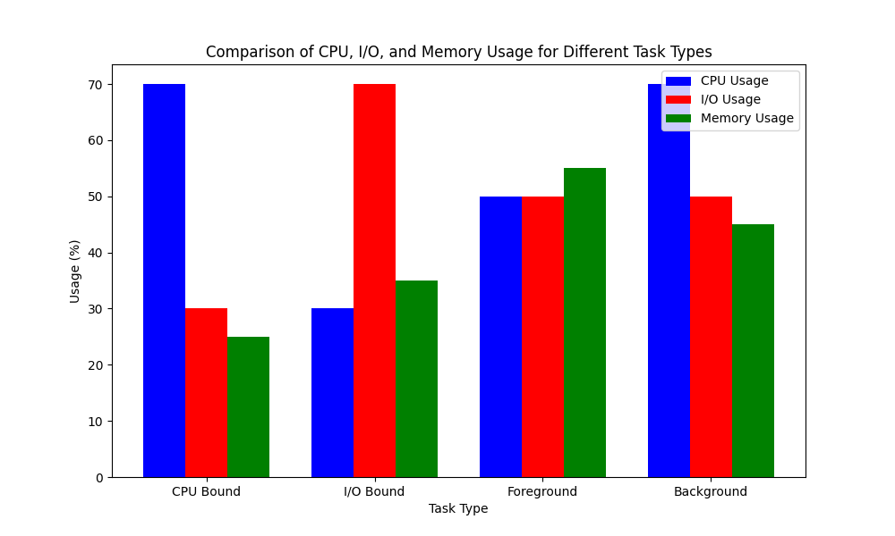
Project Progress-Data Preprocessing and Base model implementation
Data visualization: Task vs Avg. Usage (CPU, memory, io)

Slide 14
Project Progress-Data Preprocessing and Base model implementation
We have started implementing a task classification system using models like Random Forest, SVM, and others. Our focus is on training and evaluating these model’s using metrics like accuracy and precision. We are refining features, tuning hyperparameters, and analyzing misclassifications to improve performance. Through iterative testing, we aim to select the most effective model for accurate and efficient classification. Below are the Accuracy results of models we trained till now:
Random forest: 95.01%
SVM: 89.88%
XgBoost: 92.49%
KNN: 86%
MLP: 91.83%
(Results after cross validation)

Slide 15
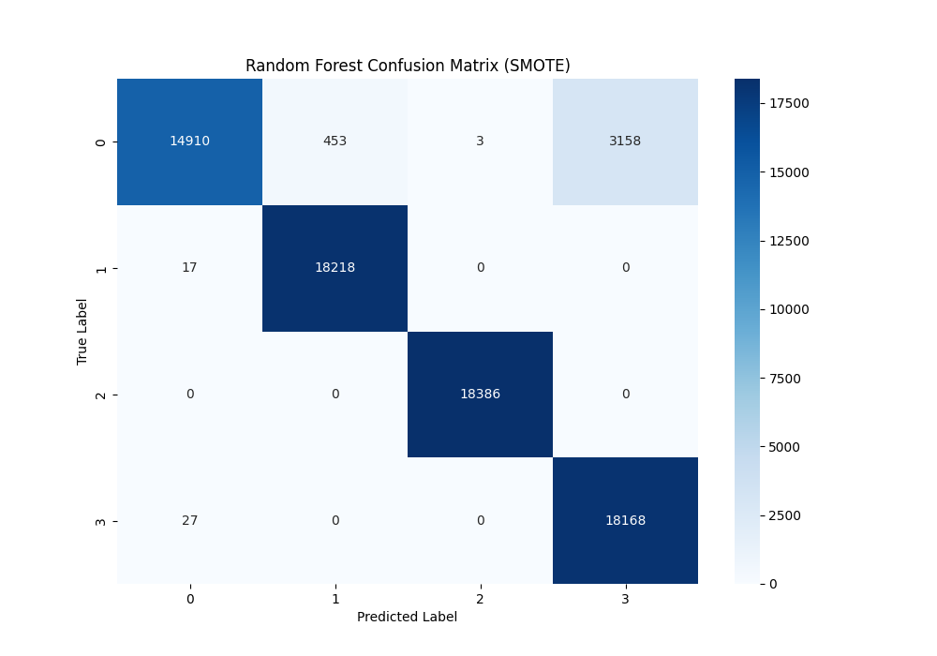
Project Progress-Data Preprocessing and Base model implementation
Random Forest Confusion matrix (Highest Accuracy model)

Slide 16
Individual Contribution
Name | Tasks | Models with accuracy
Kurumeti Prajval ( PES2UG22CS274 ) | Generated final dataset with better balanced samples using GAN model. Trained models for classification. | Random Forest : 95.01%
Manoj Kumar KS ( PES2UG22CS302) | Generated code for data extraction. Trained models for classification. | MLP : 91.83% KNN: 86%
Dhanushree K ( PES2UG22CS176 ) | Did data cleaning and preprocessing. Trained models for classification. | XGBoost:92.68%
Nagaratna ( PES2UG22CS331 ) | Analysis and feature engineering. Trained models for classification. | SVM : 89.88%

Slide 17
Capstone Phase-I timeline
Phase-1: Background Study, Problem Formulation, Literature Survey (Semester 5)
Duration: Months 1-4
Month 1:
Team formation and role allocation.
Identify areas of interest and domain selection.
Conduct initial brainstorming sessions to define a tentative problem statement.
Month 2:
Perform a detailed background study.
Collect data, identify gaps in existing solutions, and refine the problem statement.
Month 3:
Conduct an extensive literature survey (minimum 10-15 papers).
Analyze related work, existing methodologies, and tools.
Month 4:
Finalize the problem statement.
Submit the report containing the background study, refined problem statement, and literature survey.

Slide 18
Capstone Phase-II timeline
Phase-2: High-Level Design, Part of Implementation (Semester 6)
Duration: Months 5-8
Month 5:
Define system requirements and specifications.
Develop high-level architecture (flowcharts, block diagrams, UML diagrams).
Month 6:
Select tools, frameworks, and platforms for implementation.
Start implementing critical modules (proof of concept).
Month 7:
Conduct initial testing of implemented modules.
Review design and implementation progress.
Month 8:
Submit a progress report with high-level design and partial implementation details.

Slide 19
Capstone Phase-III timeline
Phase-3: Low-Level Design, Complete Implementation, Draft Paper (Semester 7)
Duration: Months 9-12
Month 9:
Develop low-level designs (detailed workflows, module-level diagrams).
Begin integrating all system modules.
Month 10:
Complete system implementation.
Perform system-level testing and debugging.
Month 11:
Analyze results and compare them with existing solutions.
Draft a research paper outlining the methodology, implementation, and results.
Month 12:
Submit a comprehensive report with low-level designs, full implementation, and the paper draft.

Slide 20
Capstone Phase-IV timeline
Phase-4: Paper Publication (Semester 8)
Duration: Months 13-16
Month 13:
Finalize the research paper (align with Scopus/Web of Science/UGC guidelines).
Perform a thorough review, incorporating mentor feedback.
Month 14:
Submit the paper to selected journals or conferences.
Begin preparing the final capstone project presentation.
Month 15:
Await feedback from the journal. Address reviewer comments if required.
Fine-tune the project report and presentation.
Month 16:
Publish the paper upon acceptance.
Deliver the final project presentation and submit the complete documentation.

Slide 21
Conclusion
The AVIOS project demonstrates the potential of integrating Artificial Intelligence into core operating system functions—specifically task scheduling. By bridging the gap between traditional static schedulers and dynamic, learning-based models, AVIOS enhances overall system performance and adaptability.
Key Takeaways
AI-driven task classification and scheduling improves CPU utilization, responsiveness, and energy efficiency.
A robust data pipeline was developed—from real-time metric collection to model-driven scheduling decisions.
Random Forest and XG Boost models have shown high accuracy in task classification, enabling intelligent resource allocation.
Future Scope
Kernel-level optimization for faster scheduling decisions.
Real-time feedback loop to enable continuous learning.
Integration with container orchestration platforms like Kubernetes for large-scale distributed systems.
AVIOS represents a step forward in creating self-optimizing, adaptive operating systems built for the future of computing.

Slide 22
References
Hongjiu Lu, ELF: From the Programmer’s Perspective, Technical Report, NYNEX Science and Technology, 500 Westchester Avenue, White Plains, NY 10604, USA, May 1995.
Aivazian, Tigran, Linux Kernel 2.4 Internals, The Linux Documentation Project, August 2002.
Maurice Bach, The Design of the Unix Operating System, Pearson Education Asia, pp. 159-170, 2002.
Fredrik Vraalsen, Performance Contracts: Predicting and Monitoring Grid Application Behavior, In Proceedings of the 2nd International Workshop on Grid Computing, November 2001.
Richard Gibbons, A Historical Application Profiler for Use by Parallel Schedulers, Lecture Notes on Computer Science, Volume 1297, pp. 58-75, 1997.
Hyok-Sung Choi and Hee-Chul Yun, Context Switching and IPC Performance Comparison between uClinux and Linux on the ARM9-Based Processor, Linux in Embedded Applications, January 2005. [Online]. .
Warren Smith, Valerie Taylor, and Ian Foster, Predicting Application Run Times Using Historical Information, Job Scheduling Strategies for Parallel Processing, IPPS/SPDP'98 Workshop, March 1998.
Kishore Kumar P. and Atul Negi, Characterizing Process Execution Behaviour Using Machine Learning Techniques, In DpROM Workshop Proceedings, HiPC 2004 International Conference, December 2004.
S.R. Garner, WEKA: The Waikato Environment for Knowledge Analysis, In Proceedings of the New Zealand Computer Science Research Students Conference, pp. 57-64, 1995.
Surkanya Suranauwarat and Hide Taniguchi, The Design, Implementation, and Initial Evaluation of an Advanced Knowledge-Based Process Scheduler, ACM SIGOPS Operating Systems Review, Volume 35, pp. 61-81, October 2001.
Mark A. Hall, Correlation-Based Feature Selection for Machine Learning, Master's Thesis, Department of Computer Science, University of Waikato, pp. 7-9, 12-14, April 1999.
Andrew Marks, A Dynamically Adaptive CPU Scheduler, Master's Thesis, Department of Computer Science, Santa Clara University, pp. 5-9, June 2003.
Robert Love, Linux Kernel Development, 1st ed., Pearson Education, 2004.
Daniel P. Bovet and Marco Cesati, Understanding the Linux Kernel, 2nd ed., O’Reilly & Associates, December 2002.
Tom Mitchell, Machine Learning, 1st ed., McGraw-Hill International Edition, pp. 52-75, 154-183, 230-244, 1997.
O. Duda and P.E. Hart, Pattern Classification, Wiley, New York, 1973.

Slide 23
Thank You

